Slide 1


Consumer Goods Ad_Hoc Insights
HARSH MISHRA

Slide 2
Code Basics SQL Challenge
REQUEST - 1 | REQUEST - 2 | REQUEST - 3 | REQUEST - 4 | REQUEST - 5
Provide the list of markets in which customer "Atliq Exclusive" operates its business in the APAC region | What is the percentage of unique product increase in 2021 vs. 2020? The final output contains these fields, unique_products_2020 unique_products_2021 percentage_chg | Provide a report with all the unique product counts for each segment and sort them in descending order of product counts. The final output contains 2 fields, segment product_count | Follow-up: Which segment had the most increase in unique products in 2021 vs 2020? The final output contains these fields, segment product_count_2020 product_count_2021 Difference | Get the products that have the highest and lowest manufacturing costs. The final output should contain these fields, product_code product manufacturing_cost
REQUEST - 6 | REQUEST - 7 | REQUEST - 8 | REQUEST - 9 | REQUEST - 10
Generate a report which contains the top 5 customers who received an average high pre_invoice_discount_pct for the fiscal year 2021 and in the Indian market. The final output contains these fields, customer_code customer average_discount_percentage | Get the complete report of the Gross sales amount for the customer “Atliq Exclusive” for each month. This analysis helps to get an idea of low and high-performing months and take strategic decisions. The final report contains these columns: Month Year Gross sales Amount | In which quarter of 2020, got the maximum total_sold_quantity? The final output contains these fields sorted by the total_sold_quantity, Quarter total_sold_quantity | Which channel helped to bring more gross sales in the fiscal year 2021 and the percentage of contribution? The final output contains these fields, channel gross_sales_mln percentage | Get the Top 3 products in each division that have a high total_sold_quantity in the fiscal_year 2021? The final output contains these fields, division product_code product total_sold_quantity rank_order

Slide 3
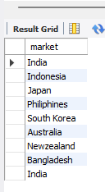

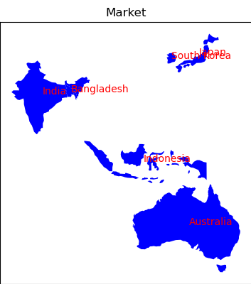
Request – 1: Solution and Insight
Atliq Hardware exclusively operates in markets within the APAC region, serving customers across 27 countries spread across four regions: APAC, EU, NA, and LATAM.

Slide 4
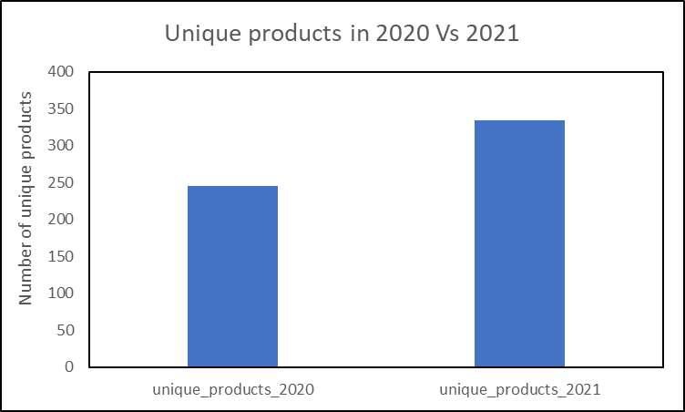
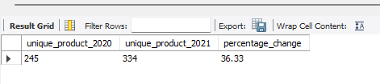

Request – 2: Solution and Insight
The unique products increased by 36% in 2021 compared to 2020

Slide 5
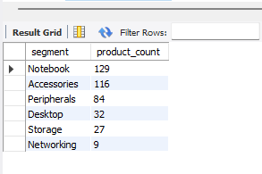
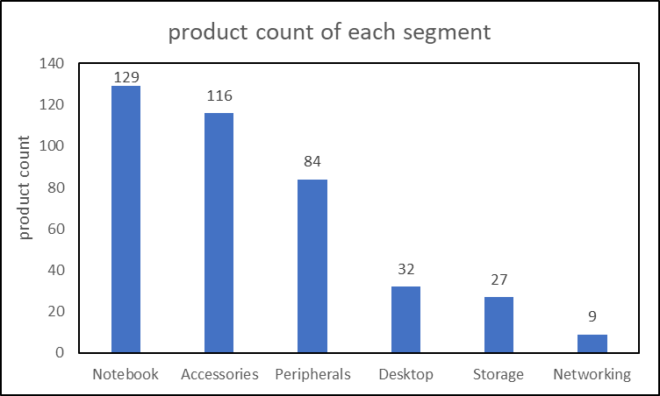
Request – 3: Solution and Insight
Notebook segment has more unique products and networking segment has less number of unique products

Slide 6
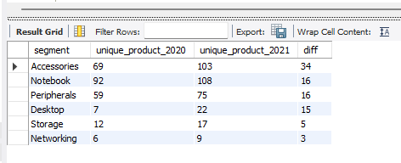
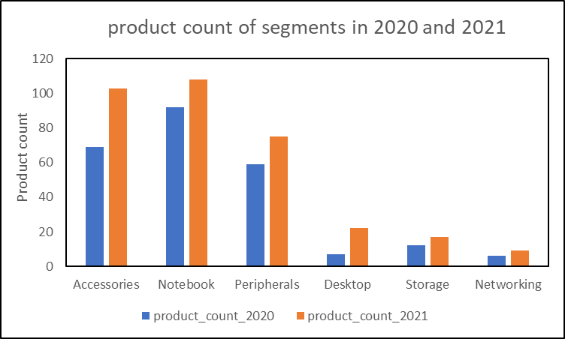
Request – 4: Solution and Insight
Accessories segment has more difference in unique products than remaining segments
Networking segment has least difference in unique products

Slide 7
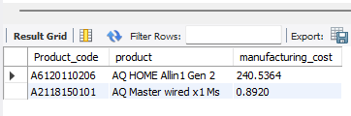
Request – 5: Solution and Insight
AQ HOME Allin1 Gen 2 product has high manufacturing cost
AQ Master wired x1 Ms product has low manufacturing cost

Slide 8
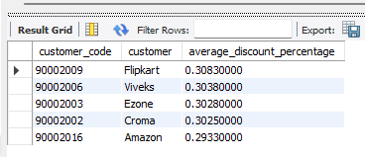
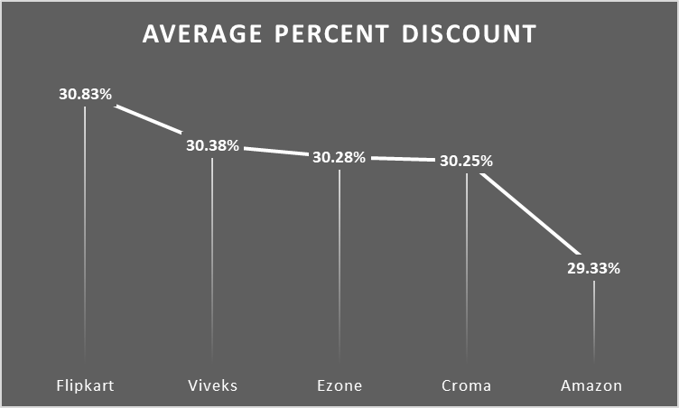
Request – 6: Solution and Insight
Top 5 customers in Indian market are Flipkart, Viveks, Ezone, Croma and Amazon
Flipkart has slightly more discount percent compared to remaining 4 customers

Slide 9
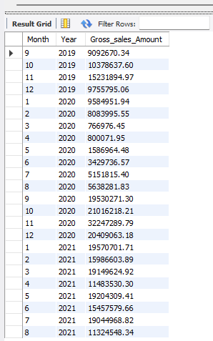
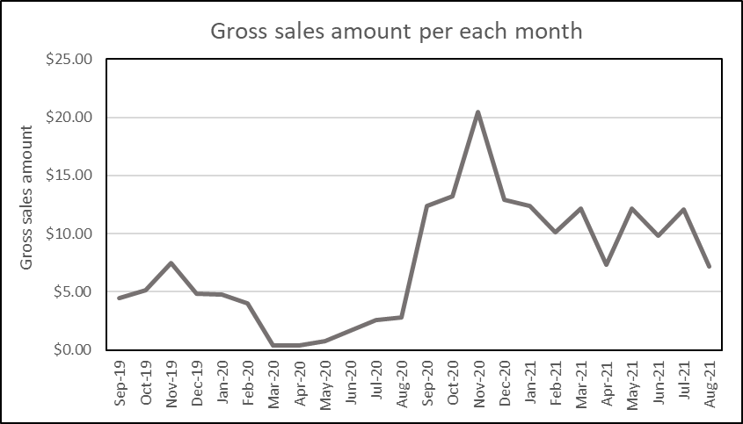
Request – 7: Solution and Insight
In the fiscal year 2020, the highest gross sale is 7.52 million dollars.
Gross sales increased tremendously in the fiscal year 2021 with highest gross sales of 20.46 million dollars.

Slide 10
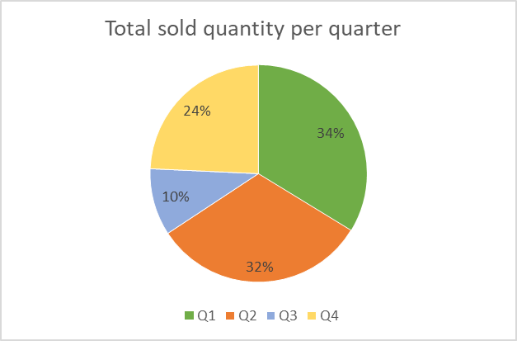
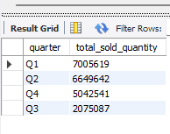
Request – 8: Solution and Insight
Quarter 1 has more total sold quantity with 7 million
Quarter 3 has low total sold quantity with 10%

Slide 11
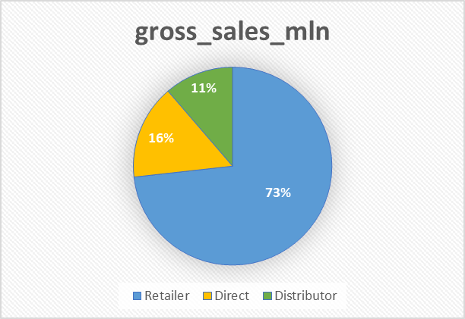
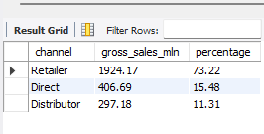
Request – 9: Solution and Insight
Retailer channel helps to bring more gross sales with 73.23% in fiscal year 2021

Slide 12
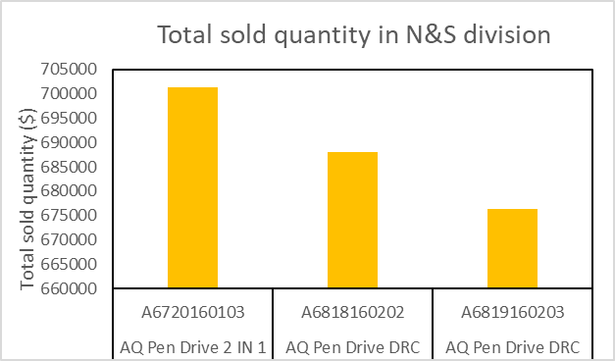
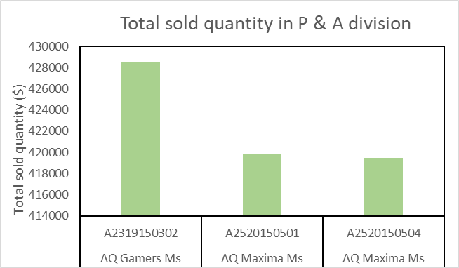
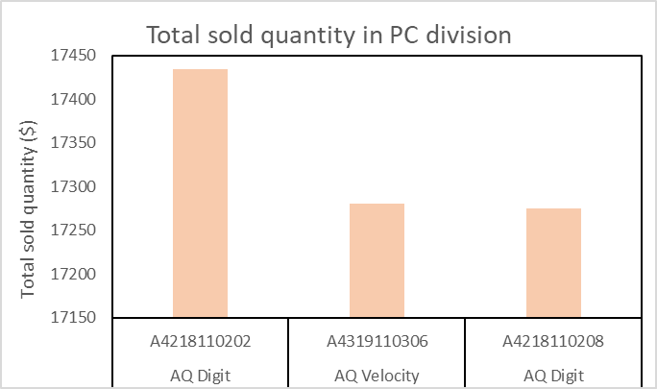
Request – 10: Solution and Insight
In N&S division, top 3 products are Pen drives and their sales are more than the other two division products
Top 3 products in P&A division are mouses and in PC division are personal computers

